Slide 1
What Can You Do with ROS-I Today?
Shaun Edwards
Sr. Research Engineer
Southwest Research Institute
Slides Shamelessly Stolen from: Jeremy Zoss

Slide 2
Overview
Hardware Support
robots, sensors, interfaces
Capabilities
simulation, planning, perception
Applications
dynamic environments, smart control

Slide 3
Hardware Support

Slide 4
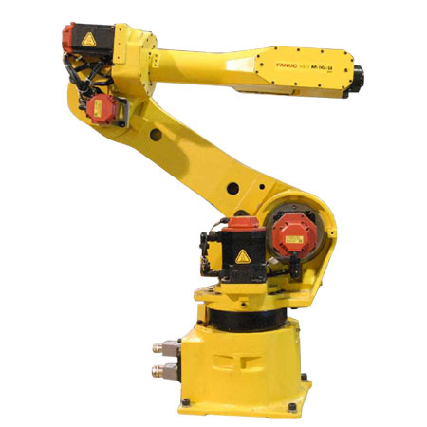
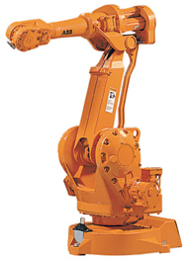
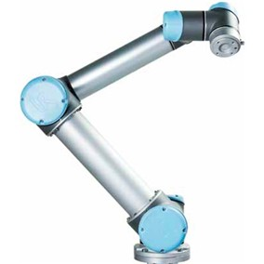
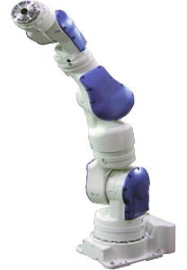
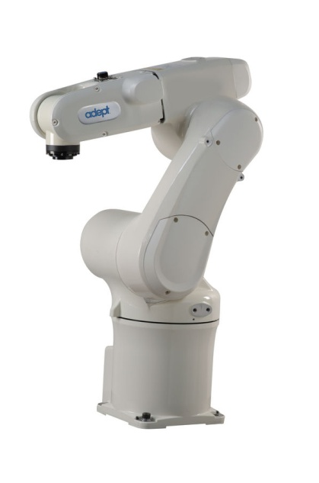
Industrial Robots
ABB
Fanuc
Universal Robots
Adept
Motoman

Slide 5

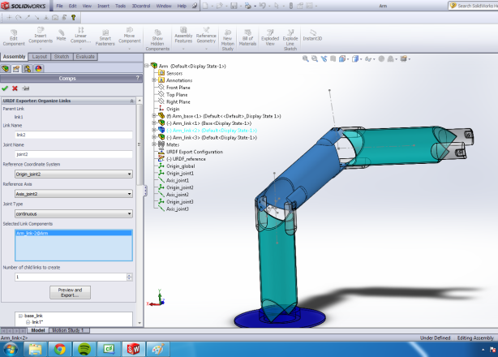
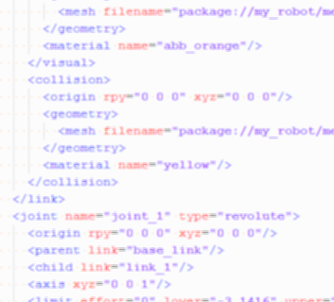
New Robot Support
Easily add support for new robot models
kinematics, STL meshes
wizards: Solidworks, Arm Navigation
config only. No software changes required!

Slide 6
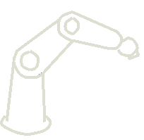


New Robot Support
Easily add support for new robot models
Framework for new robot controllers
robot-side driver/server
ROS client modifications (if needed)
communications
control
feedback
application code
algorithms
user-interface
Robot Driver / Server
motion commands
status monitoring

Slide 7
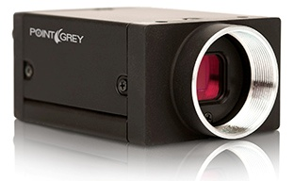
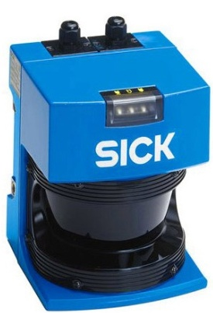
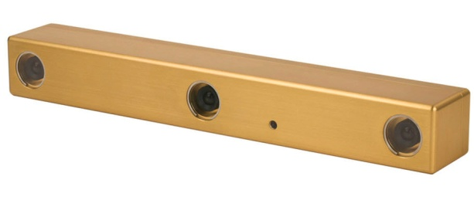
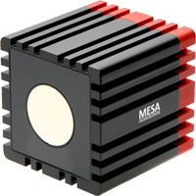
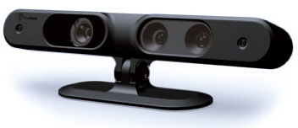
Imaging / Perception Sensors
2D Sensors
cameras (ethernet, firewire)
SICK laser rangefinder
3D Sensors
stereo vision (bumblebee)
kinect (structured light)
swissranger (flash TOF)
And more!

Slide 8
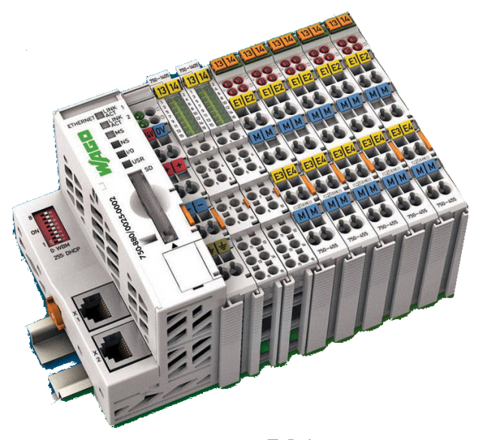
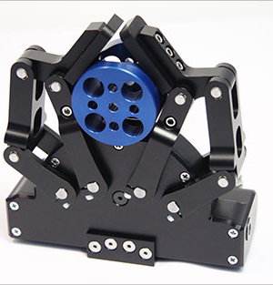
I/O Devices
Somewhat limited...
EtherCAT supported
WAGO modules: DI/O, AI/O, etc.
Robotiq gripper
Robot-connected I/O not supported (yet)

Slide 9
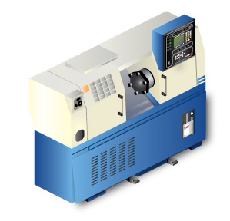

Machine Tool Interface
ROS / MTConnect bridge
communication and data-transfer
synchronize robot tending with CNC operation
MTConnect / ROS
Bridge

Slide 10
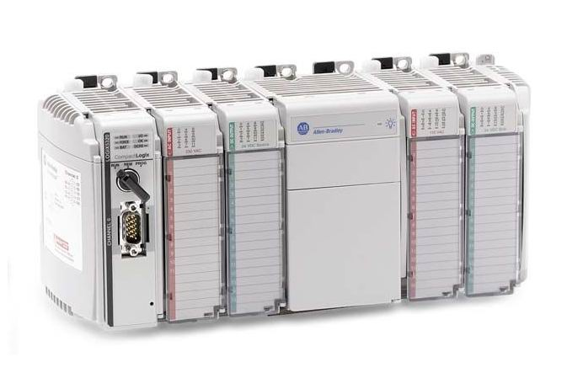


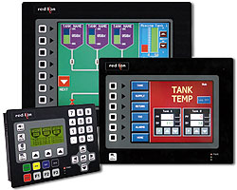


What’s Missing...
PLC Interfaces
Industrial Networks
Ethernet/IP, DeviceNet, Modbus, Profibus, etc.
OPC
Industrial HMIs

Slide 11
Capabilities

Slide 12
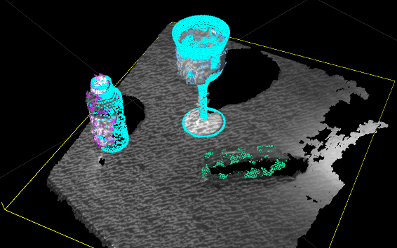
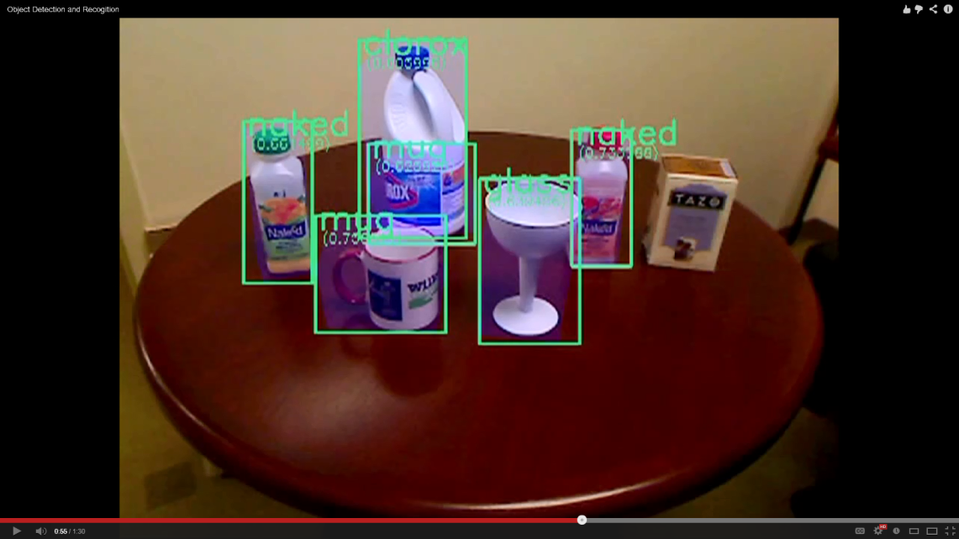
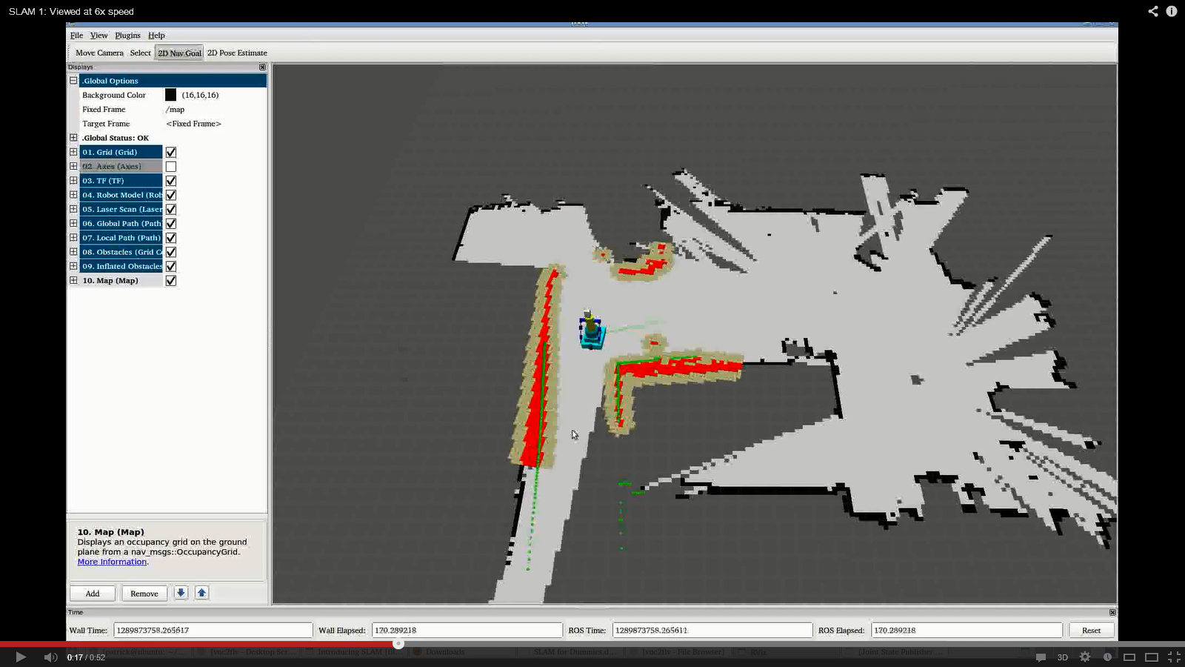
Perception
Segmentation
Identification
Mapping
Notes:
- identify discrete objects on a plane
- filter out “known” objects (robot, environment)
- monitor environment for changes
- compare against DB to classify objects
- build a 2D map on-the-fly from sensor data
- track position in known map using sensor data

Slide 13
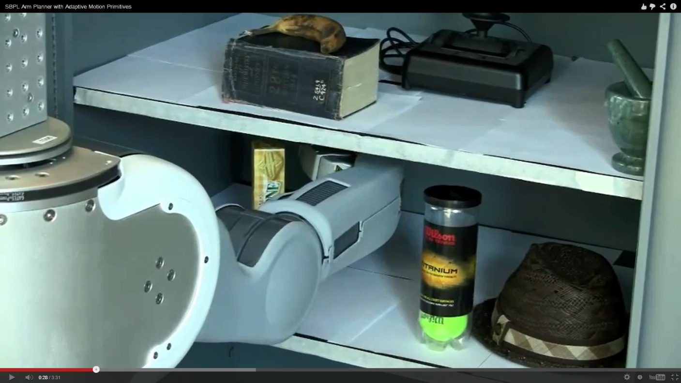

Planning
Collision-aware path planning
automatically finds path to target position
avoids obstacles, joint limits, etc.
On-the-fly checks during execution

Slide 14
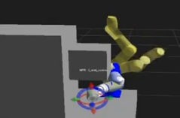
Offline Development
Strong visualization environment
review path-plans, debug control logic
develop application even with no hardware
enables smooth transition to physical system

Slide 15
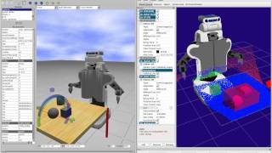
Offline Development
Strong visualization environment
Full physics-based simulation available
includes simulated sensor feedback
Gazebo

Slide 16
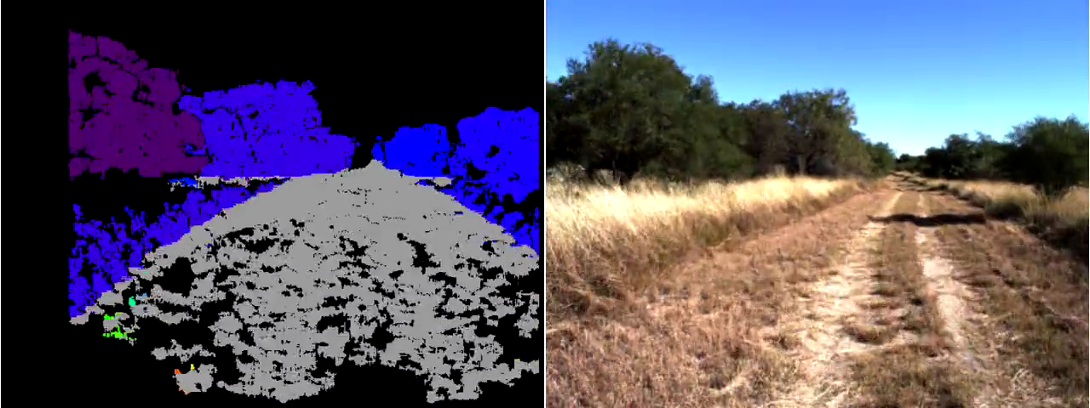
Offline Development
Strong visualization environment
Full physics-based simulation available
Can record and replay data
both sensor and control data
aids development and troubleshooting

Slide 17
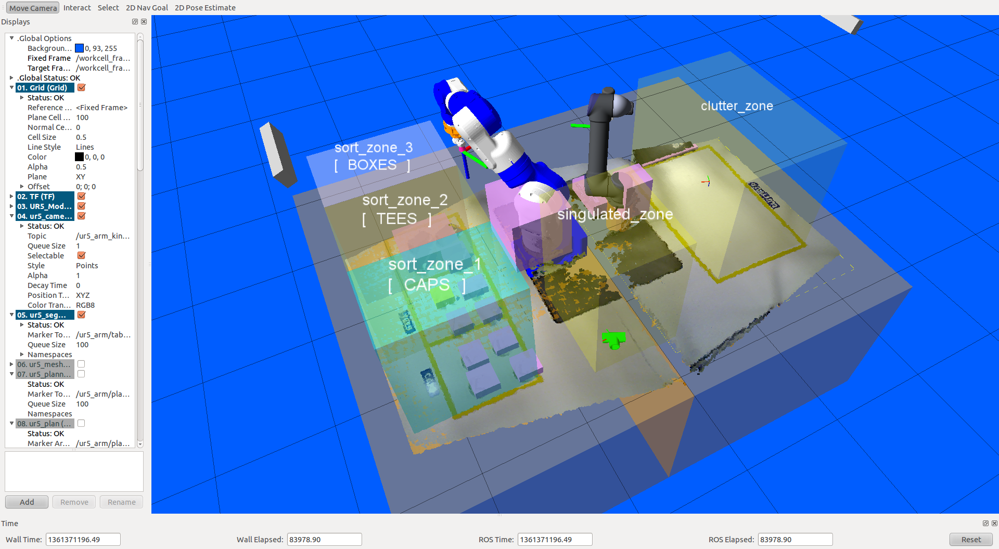
Online Visualization
Update visualization based on live sensor feedback
remote process monitoring
“augmented reality” displays

Slide 18

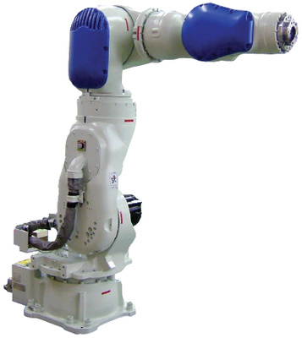
Hardware Independence
Run the same program on different robot platforms.
reduce software “porting” burden
select robot based on capabilities, rather than familiarity

Slide 19
What’s Missing
Precision control of path pos/vel/timing
Simplified programming interface
Motion-related triggers
process control based on path timing
Dynamic path modification
adjust motion based on sensor feedback

Slide 20
Applications

Slide 21
Unknown Part Stream
Technologies
3D scanning
segmentation, filtering
dynamic path planning
large, variable inventory
high-mix, low-lot production

Slide 22
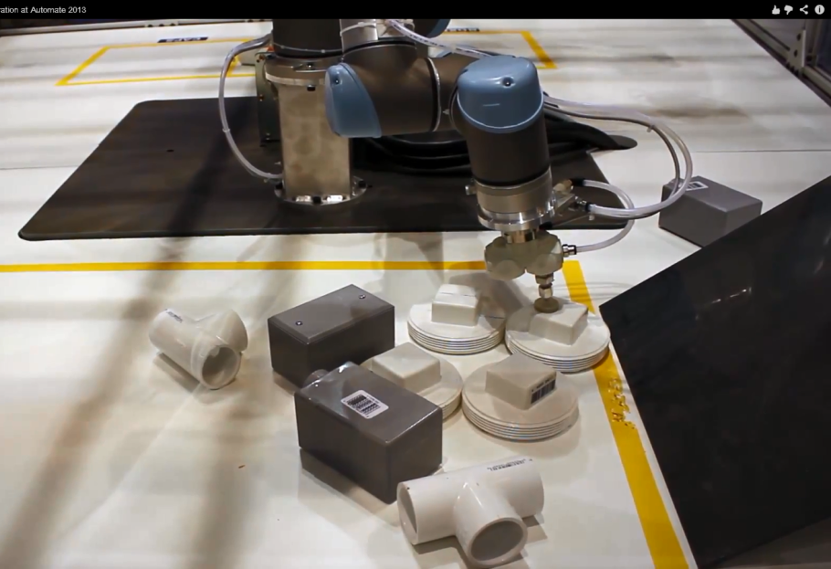
Unstructured Picking
Technologies
3D scanning
segmentation
filtering
path planning
known parts, but random placement
partial occlusions

Slide 23
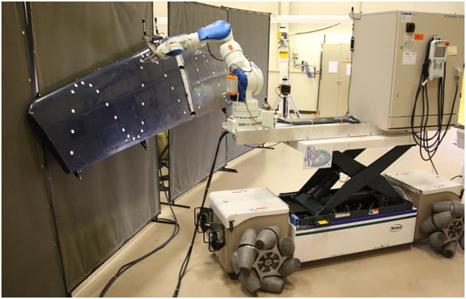
Mobile Robots
Technologies
base / arm support
mapping
localization
path planning
navigation
inventory management
large workspaces

Slide 24
CAD &PLAN/SCAN & PLAN
Technologies
CAD/3D Scanning
Semi-Constrained Path Planning
Visualization
Dynamic Painting, Deburring, Machining
Low Volume/High Mix

Slide 25
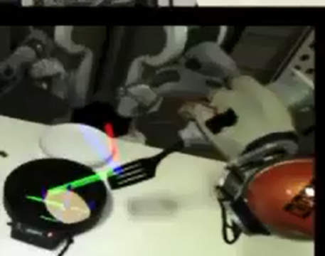
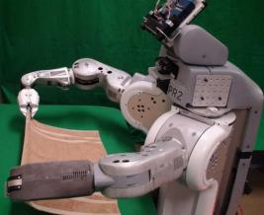
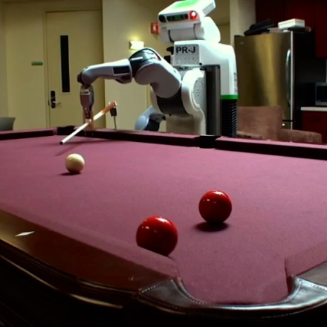
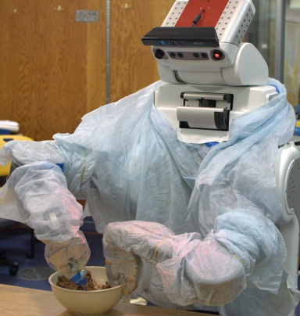
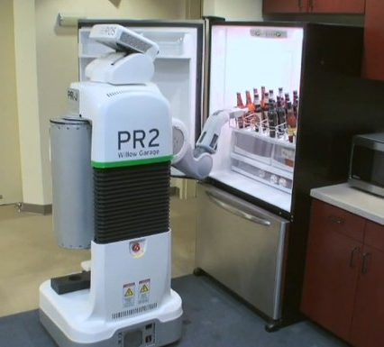
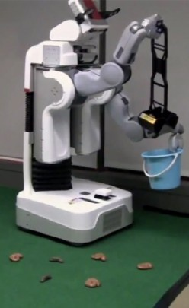
Less-Industrial Applications
cook breakfast
fold laundry
play pool
bake cookies
fetch beer
scoop poop

Slide 26
Summary
Hardware Support
robots: fair, sensors: many, I/O: few
Capabilities
3D perception and planning
Applications
dynamic parts, environment, planning
standard control/monitoring interfaces

Slide 27
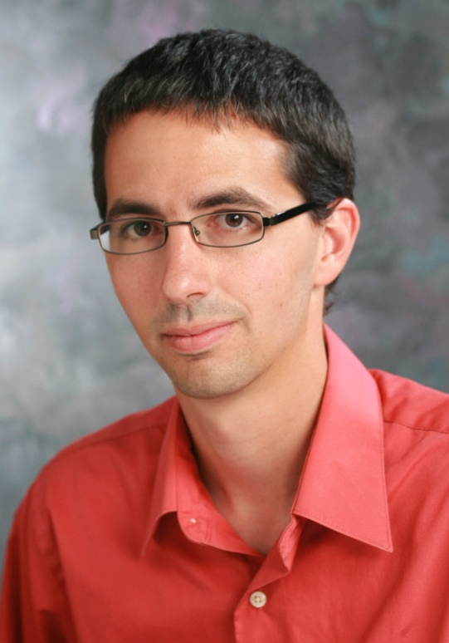
Contact Information
Shaun Edwards Senior Research Engineer
Southwest Research Institute
6220 Culebra Rd.
San Antonio, TX 78251 US
Phone: 210-522-3277 Email: sedwards@swri.org
www.rosindustrial.org
www.ros.org/wiki/Industrial

